Slide 1
POLARS
Yvonne Jiang
OIM 7502 Spring 2024 – Midterm Project

Slide 2
What is Polars?
Polars is a DataFrame library to manipulate structured data.
It is available for Python, R and NodeJS.

Slide 3

Why Polars?

Slide 4
Key Advantage 1: Support all common data formats
Text
CSV
JSON
Binary
Parquet
Delta Lake
AVRO
Excel
IPC
Feather
Arrow
Databases
MySQL
Postgres
SQL Server
Sqlite
Redshift
Oracle
Cloud
S3
Azure
Blob

Slide 5




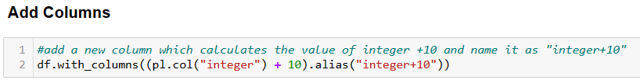
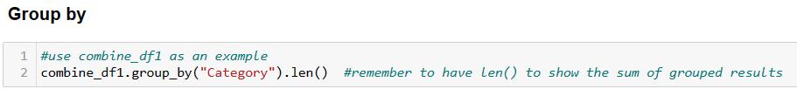
Key Advantage 2: Easy to use

Slide 6
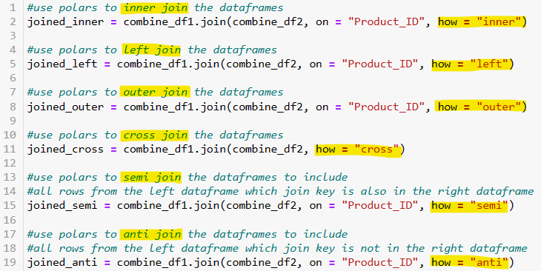

Key Advantage 2: Easy to use
Method 1
Method 2
Combine Dataframes

Slide 7
Key Advantages 3: Fast
DEMO

Slide 8
Key Advantage 4: Lazy API
Lazy API allows users to specify a sequence of operations but not running them immediately
Optimize queries before execution
Catch schema error before execution
Memory-efficient queries

